Slide 1
Nexus Research hub
Presented by Hiteshi Mahajan, Srimahi Dey Sunil Janni

Slide 2
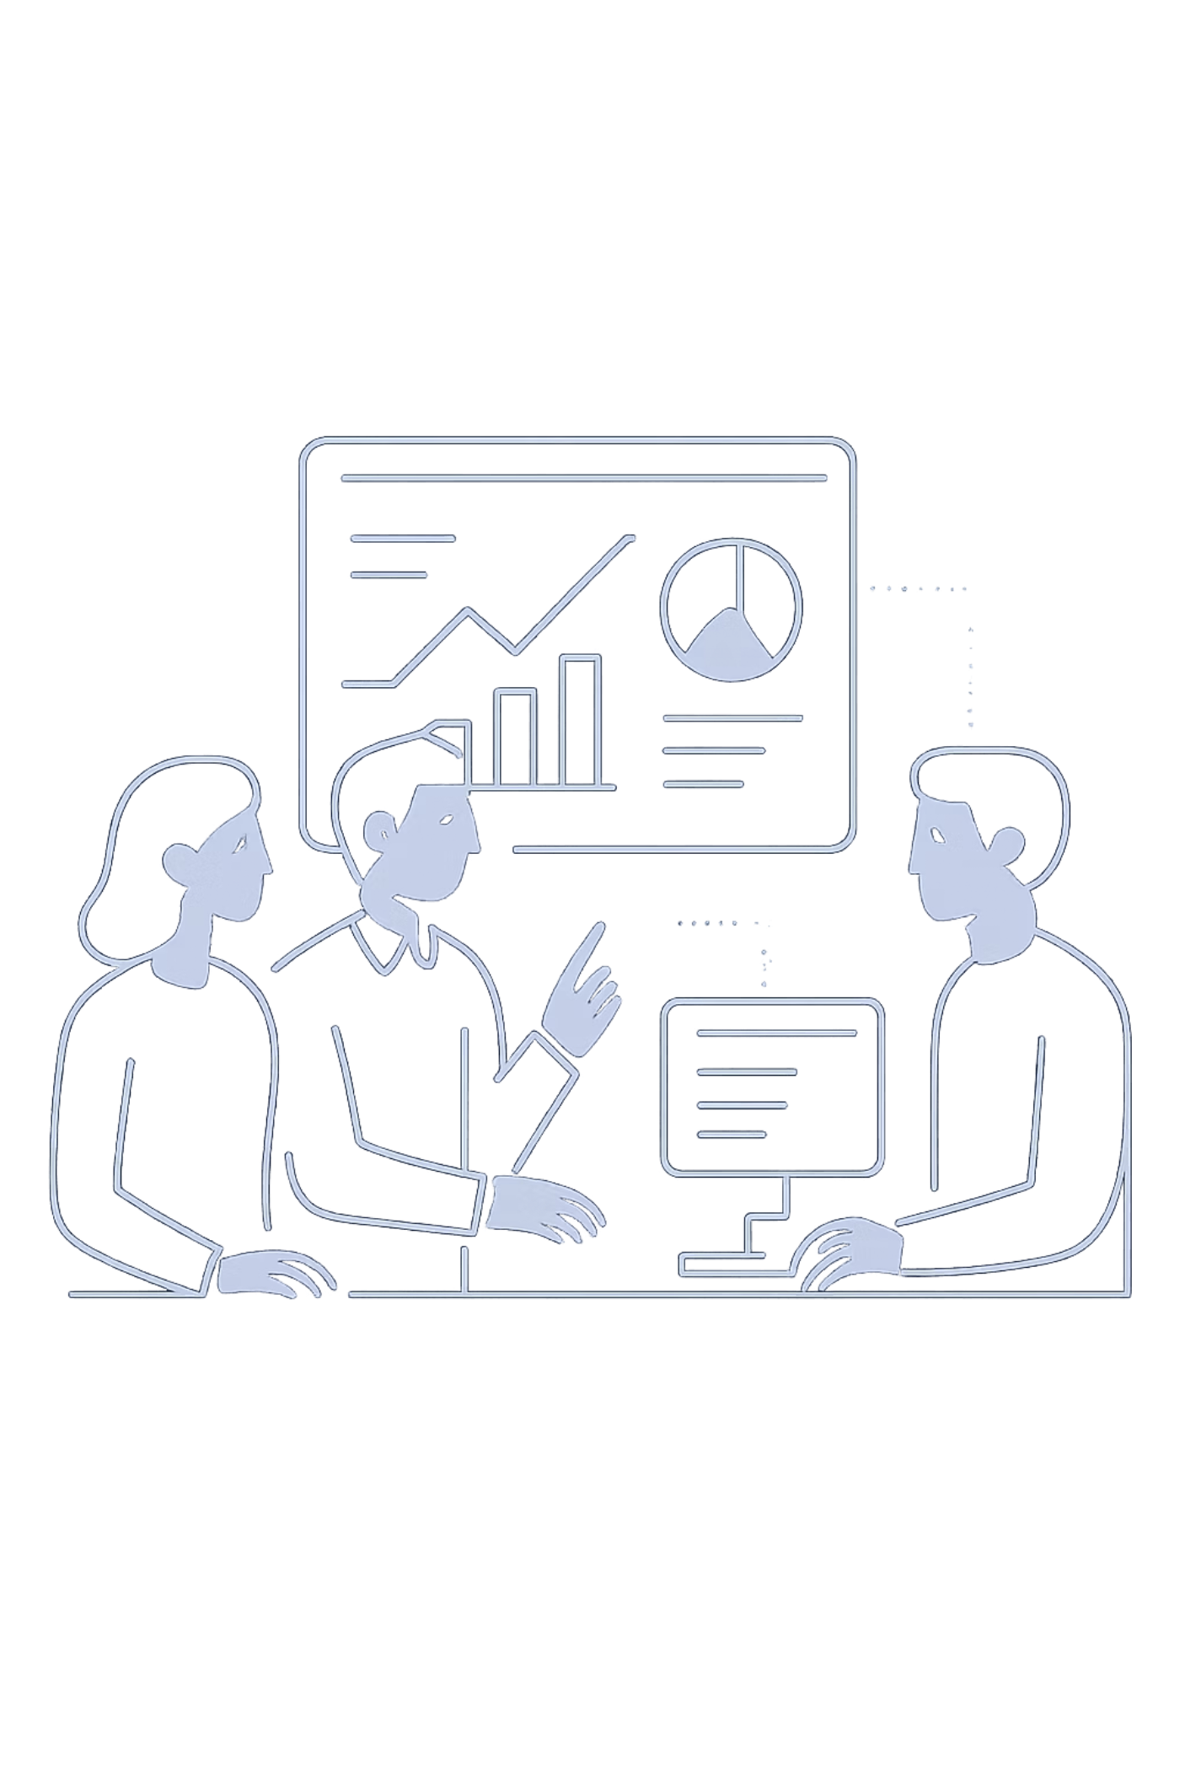
Revolutionizing Research: The Unified Knowledge Hub
A next-generation platform designed to bring structure, collaboration, and clarity to the way research teams capture, connect, and discover knowledge — from the first experiment to the final discovery.
RESEARCH PLATFORM
KNOWLEDGE MANAGEMENT
TEAM COLLABORATION

Slide 3
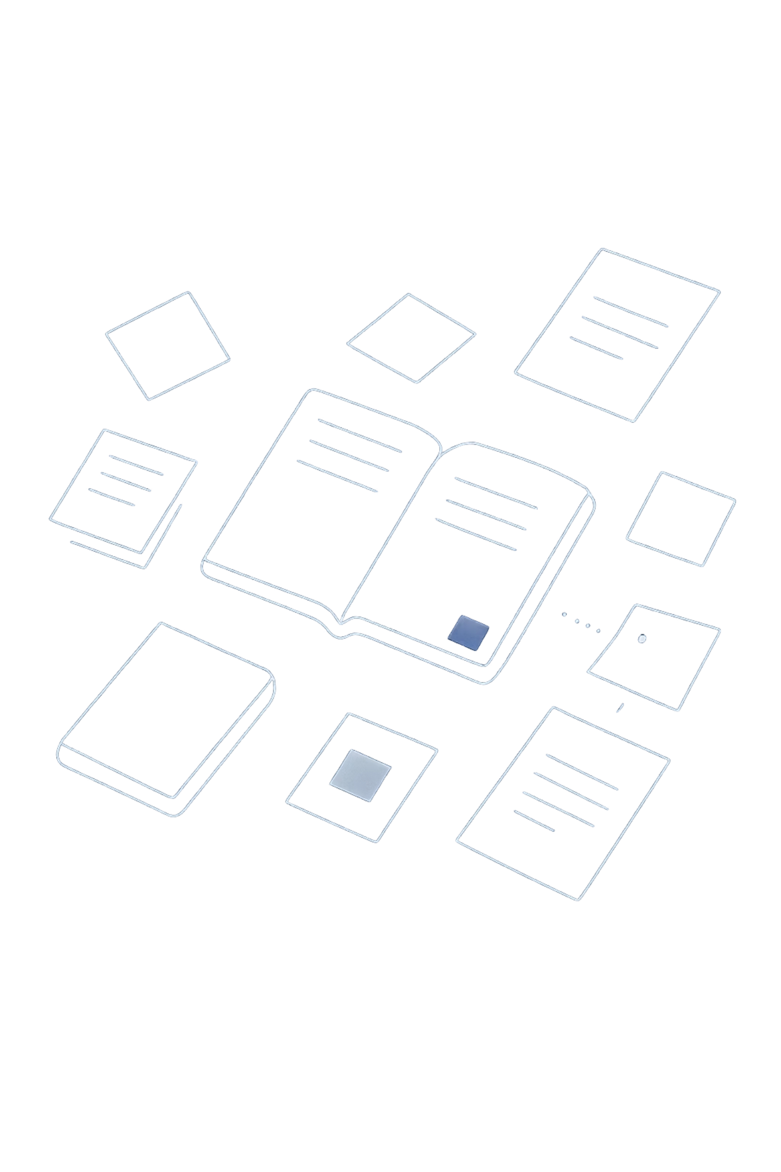
The Challenge: Disconnected Research Data
Modern research teams are drowning in fragmented information. Notes live in separate documents, references sit in isolated managers, and experiment logs are buried in shared drives. The result is chaos — and lost science.
Fragmented Information
Scattered notes, disparate reference managers, and unlinked experiment logs create a web of disconnected data that is nearly impossible to navigate efficiently.
Collaboration Breakdown
Without a shared source of truth, tracking changes, aligning on findings, and maintaining context across team members becomes a constant source of friction and miscommunication.
Lost Time & Errors
Fragmented research processes waste valuable hours and introduce the potential for critical errors — from misattributed data to irreproducible experiments.

Slide 4
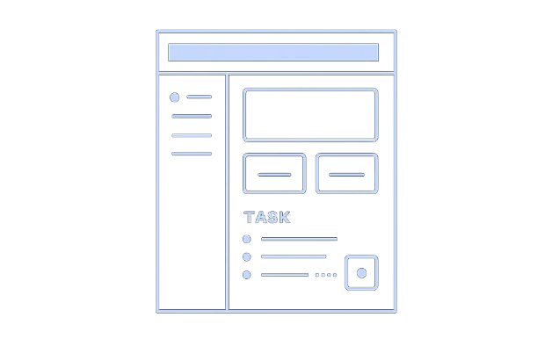
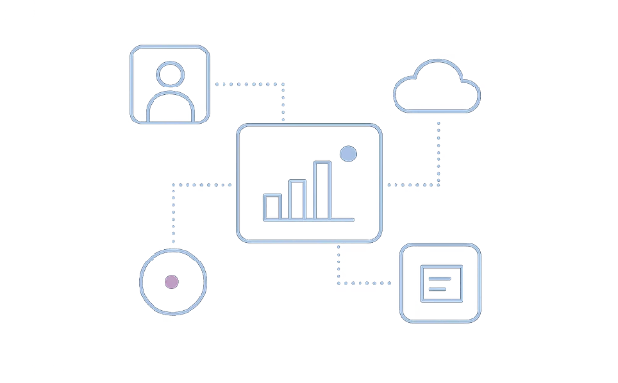
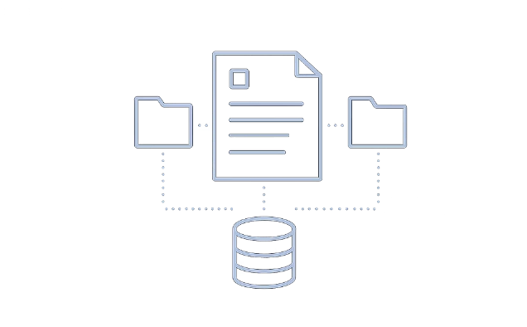
Introducing the Unified Research Platform
One platform. Every research activity. Complete context. The Unified Research Platform consolidates everything your team needs into a single, connected environment — eliminating silos and accelerating discovery.
Centralized Hub
Contextual Linking
Integrated Attachments
All research activities — notes, references, and experiment logs — live in one unified workspace, accessible to every authorized team member.
Seamlessly link notes, logs, and datasets to research topics, building a living knowledge graph that preserves context and relationships over time.
Attach files, datasets, and relevant documents directly to your research entries, ensuring every asset is connected to the work it supports.

Slide 5
Structured Notes & Experiment Logs
SciNote Electronic Lab Notebook
Jacquard: Fine-Grained Provenance
SciNote offers robust features for structured data entry and experiment tracking. Researchers can maintain detailed experiment logs with built-in version history, ensuring full reproducibility and audit trails for every study.
The Jacquard project explores fine-grained provenance for empirical research, emphasizing how data and analysis steps are linked. It addresses critical questions like "How was this result generated?" and "What assumptions were made?"
Structured templates for consistent data capture
Timestamped experiment logs with full history
Reproducibility built into every entry
Links data to analysis steps transparently
Tracks provenance at a granular level
Supports empirical research integrity

Slide 6
Version Control & Collaboration
Research evolves — and your platform should keep up. Powerful version control and collaborative tools ensure your team always knows what changed, who changed it, and why.
File Version History
Provenance Tracking
Section-Level Commenting
SciNote provides File Version History, allowing users to access, download, and restore previous versions of any file — protecting against accidental overwrites and preserving the full research record.
Jacquard improves version control and provenance for empirical research, directly addressing questions like "What's changed recently?" and "How did we generate this chart?"
Collaborative commenting on specific sections of notes and logs keeps teams aligned. Feedback is anchored to the exact content it references, eliminating ambiguity and streamlining review cycles.

Slide 7
Linking Notes to Research Topics
Context is everything in research. By connecting individual notes and experiment logs to broader research topics, the platform creates a living knowledge graph that grows smarter with every entry.
Tags & Lists
Topic Linking
Knowledge Graph
Inspired by Papers, users can add Tags and Lists as optional columns in their library table view, aiding in organization and quick scanning of references across any research domain.
This tagging concept extends to linking notes and logs to broader research topics, creating a connected knowledge graph that surfaces relationships between experiments, findings, and hypotheses.
Over time, the platform builds a rich, interconnected web of research knowledge — making it easy to trace how ideas evolved, which experiments informed which conclusions, and where gaps remain.

Slide 8

Powerful Search Capabilities
Finding the right information at the right time is critical. The platform's search engine is designed to surface insights across your entire research knowledge base — instantly.
Enhanced Tags — SciNote
Universal Cross-Note Search
SciNote enhances searchability with Enhanced Tags that are workspace-wide, allowing researchers to filter and locate content across all projects and team members without switching contexts.
The platform will enable cross-note searching, allowing users to find information across all stored research data — regardless of where it was originally captured. Search by keyword, tag, author, date, or linked topic to surface exactly what you need.
Advanced Search — NotePlan
NotePlan offers Advanced Search and a Command Bar for efficient information retrieval, enabling power users to query their notes with precision and speed.
Search spans notes, experiment logs, references, and attached files — a single query reaches everything.

Slide 9
Key Features at a Glance
Every feature is designed to remove friction and amplify the impact of your research team's work.
Structured Notes & Logs
Reference Management
Organize research with dedicated fields and templates for consistent, reproducible documentation.
Link to external or internal reference libraries, keeping citations connected to the work they support.
File & Dataset Attachment
Version History
Keep all research assets — files, datasets, and documents — in one place, attached directly to relevant entries.
Track every change and revert to previous states with full audit trails for complete research integrity.
Collaborative Commenting
Universal Search
Facilitate team communication on specific details with section-level comments anchored to the content.
Find any information across the entire knowledge base with a single, powerful search query.

Slide 10
Transforming Research Workflows
The difference between a fragmented process and a unified platform is not just convenience — it's the difference between stalled projects and accelerated discovery.
Before the Platform
After the Platform
Fragmented data scattered across tools and drives
Lost context when team members change or projects evolve
Unified knowledge base with everything connected and contextual
Clear provenance and full version history for every entry
Collaboration friction from unclear ownership and version confusion
Hours wasted searching for information that should be easy to find
Efficient collaboration with section-level comments and shared context
Accelerated discovery as teams focus on innovation, not data management

Slide 11
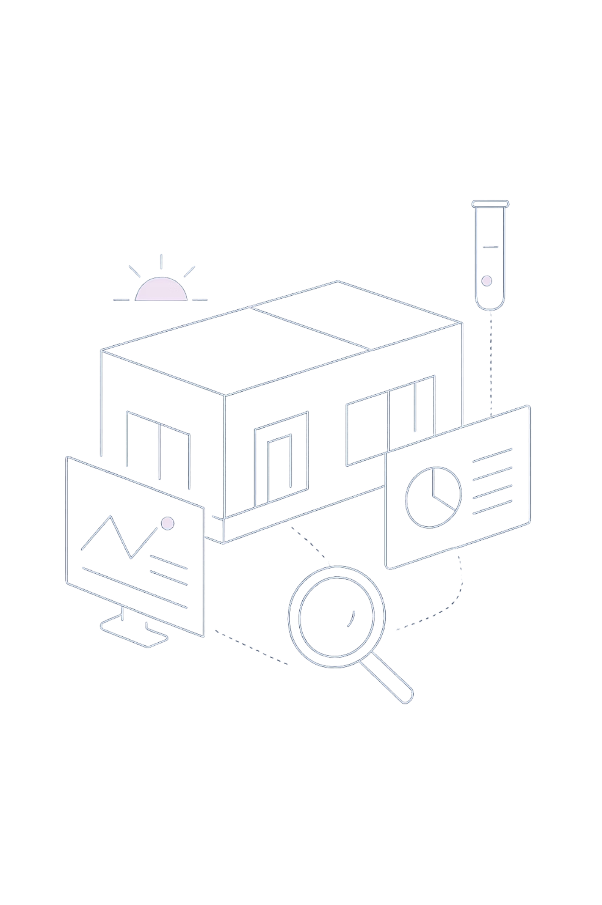
The Future of Research Collaboration Starts Here.
The Unified Research Platform is more than a tool — it's a transformation in how teams think, work, and discover together. By unifying notes, references, experiment logs, and collaboration into a single intelligent system, research teams can finally focus on what matters most: pushing the boundaries of knowledge.
Unify Your Research
Empower Your Team
Bring every note, log, and dataset into one connected platform.
Give collaborators the context, version history, and tools they need to excel.
Accelerate Discovery
Remove the friction of data management and unlock your team's full potential.

